Slide 1
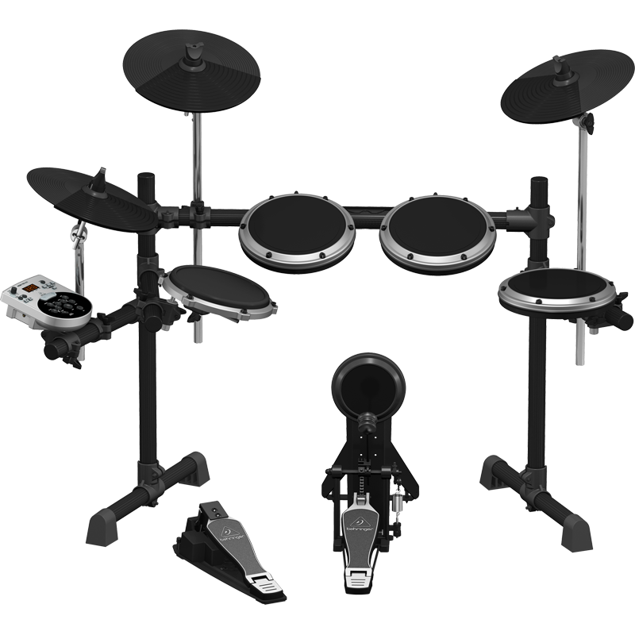
Arduino Drum MIDI
Team members:
Elena Soledad Medina Favela José Marcos Morales Gómez
Rodrigo Moguel Gamboa Víctor Manuel Ortiz García

Slide 2
Mapping Requirements

Slide 3
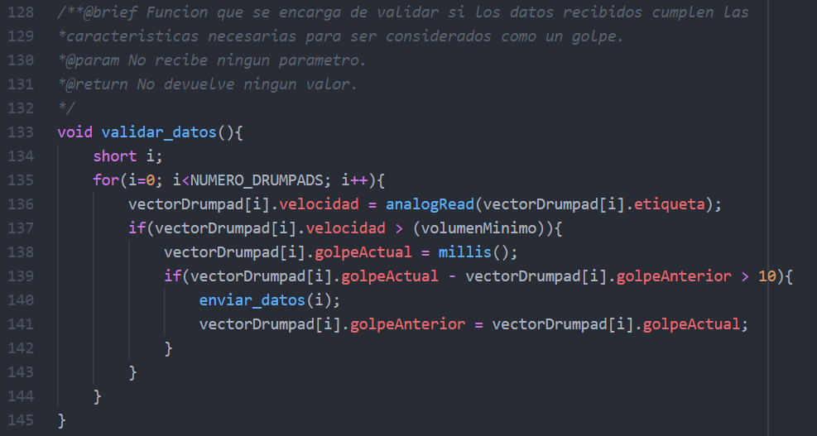
FR000: When you hit a sensor, an input data is generated.
FR001: The system constantly reads the input data and stores it in a memory space.

Slide 4
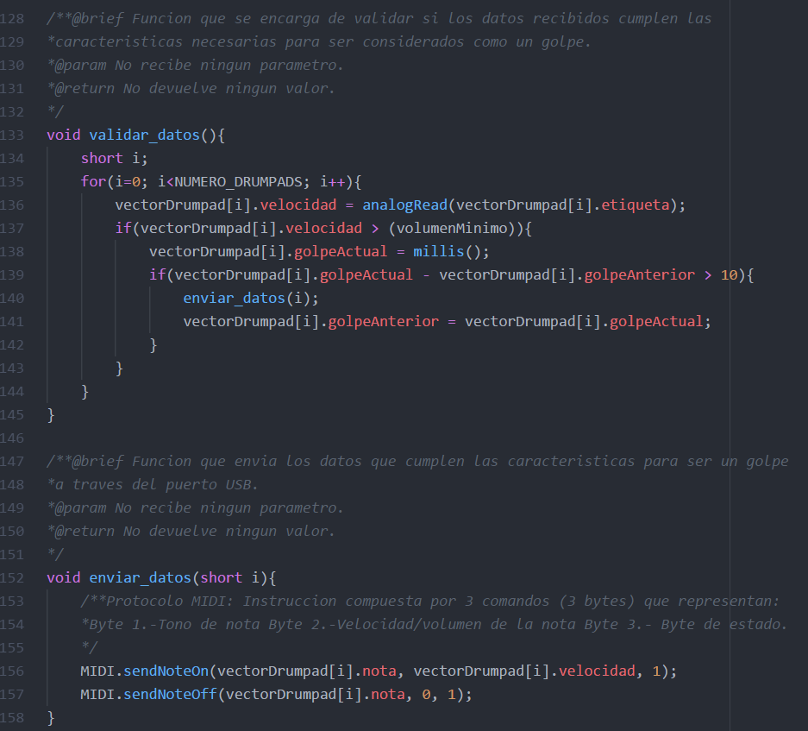
FR002: In the case where the stored data is valid, a command based on the MIDI protocol will be generated.

Slide 5
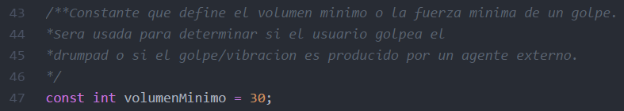
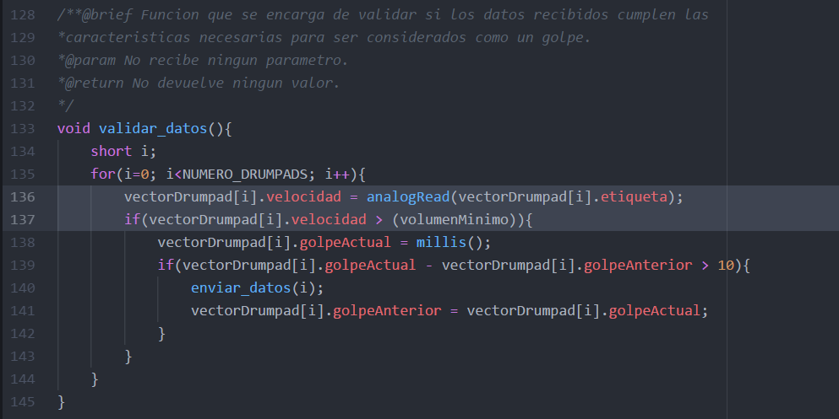
NFR000: Each sensor has a minimum force assigned so that the data generated by residual vibrations or interference are not valid.

Slide 6
NFR001: The volume of the musical note generated is associated with the strength that the sensor receives when struck.

Slide 7
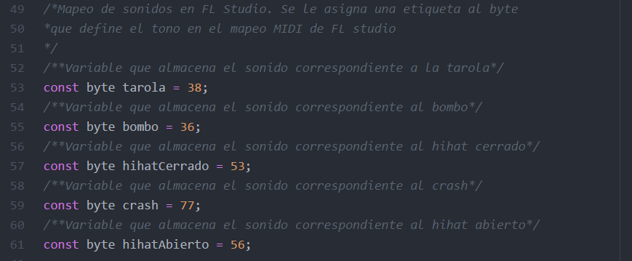
NFR002: Each sensor has a unique musical note with respect to the rest of the sensors.

Slide 8
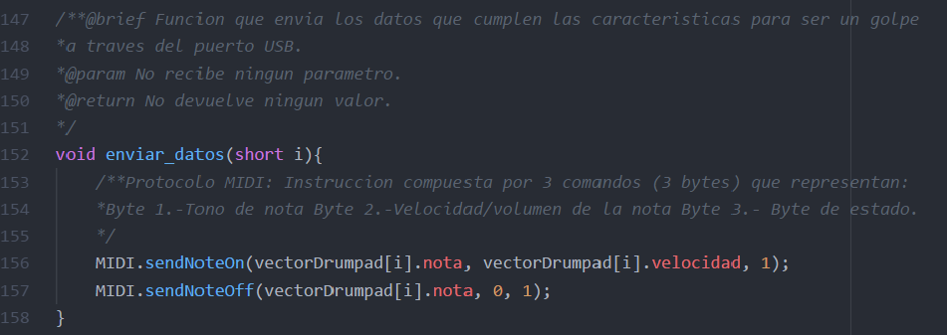
FR003: The generated command is sent to the output port of the device.

Slide 9
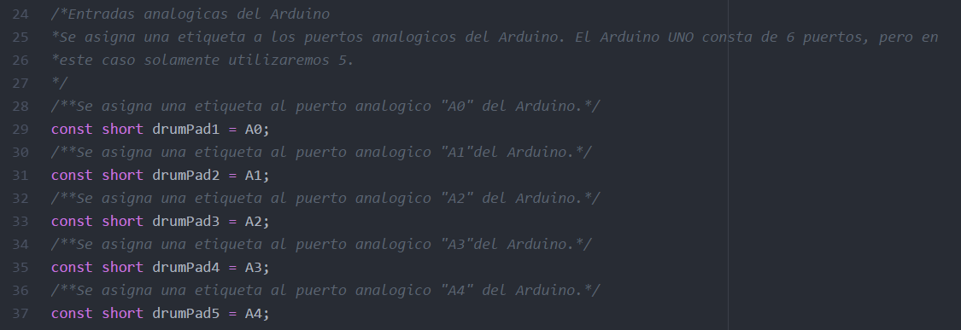
FR004: By hitting two or more sensors at the same time, the sounds will be heard simultaneously.
MIDI communication is serial, therefore the data transmission is carried out one after the another, but this transmission is executed so fast that it seems that the sounds are reproduced simultaneously.
NFR003: The system accepts a máximum of six sensors defined from the beginning.

Slide 10
Use Cases

Slide 11

Diagram of use cases
System
Constant storage of information
Validation of stored information
User
Command generation

Slide 12
Documentation

Slide 13
Documentation
Coding standard Cambridge
Name in repository: Estándar de codificación -Cambridge-
Doxygen – Repository
Name in repository: Documentation

Slide 14
Modularity

Slide 15
Organization of the system in general
Arduino is executed
Reserve memory space
Call function: setup()
Call function: loop()
Call function:
validar_datos()
Call function:
enviar_datos()
USB port
PC

Slide 16
Development process

Slide 17
Individual Productivity
20% Attend all team meetings. (The percentage is divided by the number of meetings). Attendance.
30% Deliver your part of work on time. (The percentage is divided by the number of assigned works). Responsability.
25% Respect the coding standard. (The percentage is divided by the number of code works that are assigned individually) Know how to follow instructions.
25% Provides solutions and ideas during group meetings. Proactivity.

Slide 18
Evaluation of individual participation
 | Elena | Rodrigo | Marcos | Víctor
First delivery | 50% | 30% | 20% | 0%
Second delivery | 45% | 25% | 15% | 15%
Final delivery | 45% | 25% | 15% | 15%

Slide 19
Repository
Link: https://github.com/Flowah155/ArduinoElectricDrum

